Slide 1

GENDER DETECTION AND AGE PREDICTION USING OPENCV AND CAFFE
SWARNANDHRA COLLEGE OF ENGINEERING AND TECHNOLOGY
(AUTONOMOUS)
Department of Computer Science and Engineering
TEAM MEMBERS:
P.Naga Satya Sai(18A21A0564)
K.Ramesh(18A21A05A1)
P.Pavan Sita Ram(18A21A0580)
T.R.S.Jagan(18A21A05A5)
S.Ramanjaneyulu(19A25A0511)
UNDER THE GUIDANCE OF : Dr.B.Rama Krishna Sir

Slide 2
ABSTRACT
To build a gender and age detector that can approximately guess the gender and age of the person (face) in a picture or through webcam. In this Python Project, we had used Deep Learning to accurately identify the gender and age of a person from a single image of a face. We used the models trained by using caffe framework. The predicted gender may be one of ‘Male’ and ‘Female’, and the predicted age may be one of the following ranges- (0 – 2), (4 – 6), (8 – 12), (15 – 20), (25 – 32), (38 – 43), (48 – 53), (60 – 100) (8 nodes in the final softmax layer). It is very difficult to accurately guess an exact age from a single image because of factors like makeup, lighting, obstructions, and facial expressions. And so, we made this a classification problem instead of making it one of regression. For this project we used the Adience dataset in Kaggle.The dataset is available in the public domain. This dataset shas a total of 26,580 photos of 2,284 subjects in eight age ranges (as mentioned above) and is about 1GB in size. This dataset serves as a benchmark for face photos and is inclusive of various real-world imaging conditions like noise, lighting, pose, and appearance. The images have been collected from Flickr albums and distributed under the Creative Commons (CC) license. It models we used are trained on this dataset.

Slide 3
CONTENTS
Project Demonstration
Need for the project
Introduction
Literature Survey
Existing System
Proposed System
J48 Algorithm
UML Diagrams
Requirements
Project Overview
Convolutional Neural Networks
System Design
CNN for Gender and Age Estimation
Network Architecture
Training and Testing
Advantages
Applications
Conclusion
References

Slide 4

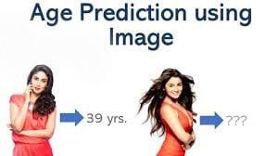
GENDER DETECTION AND AGE PREDICTION

Slide 5
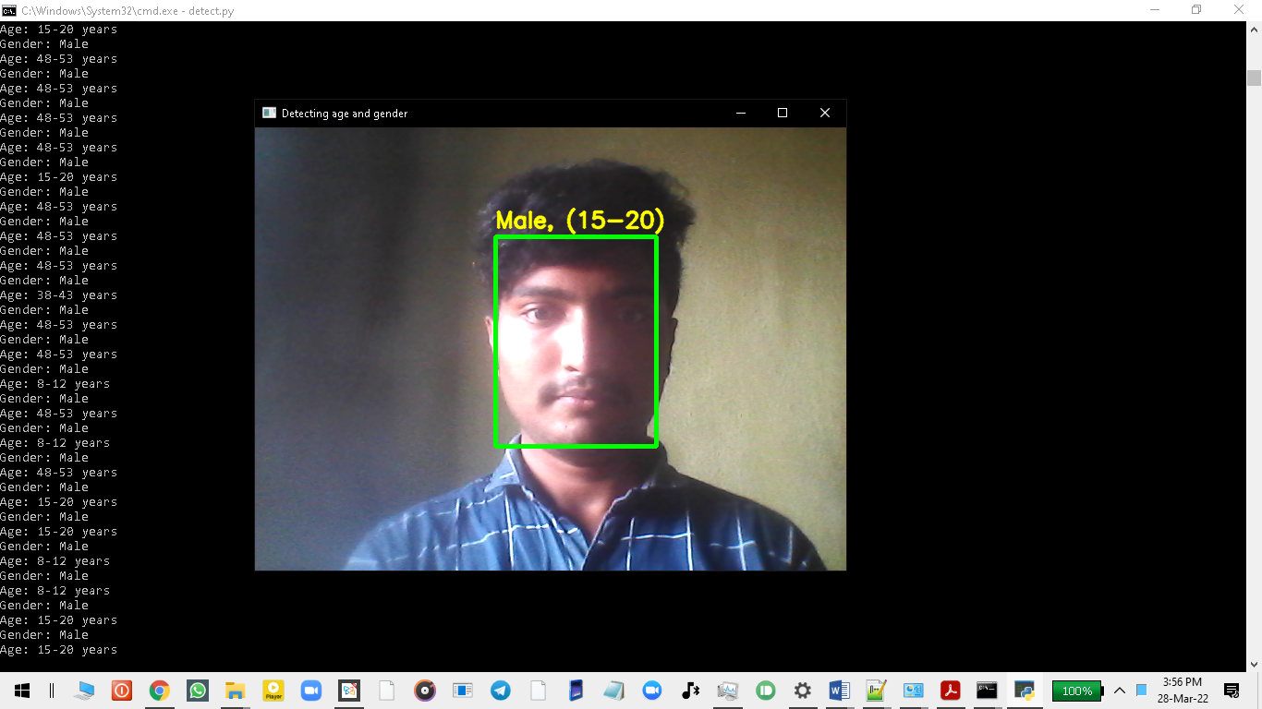
1.INPUT FROM CAMERA

Slide 6
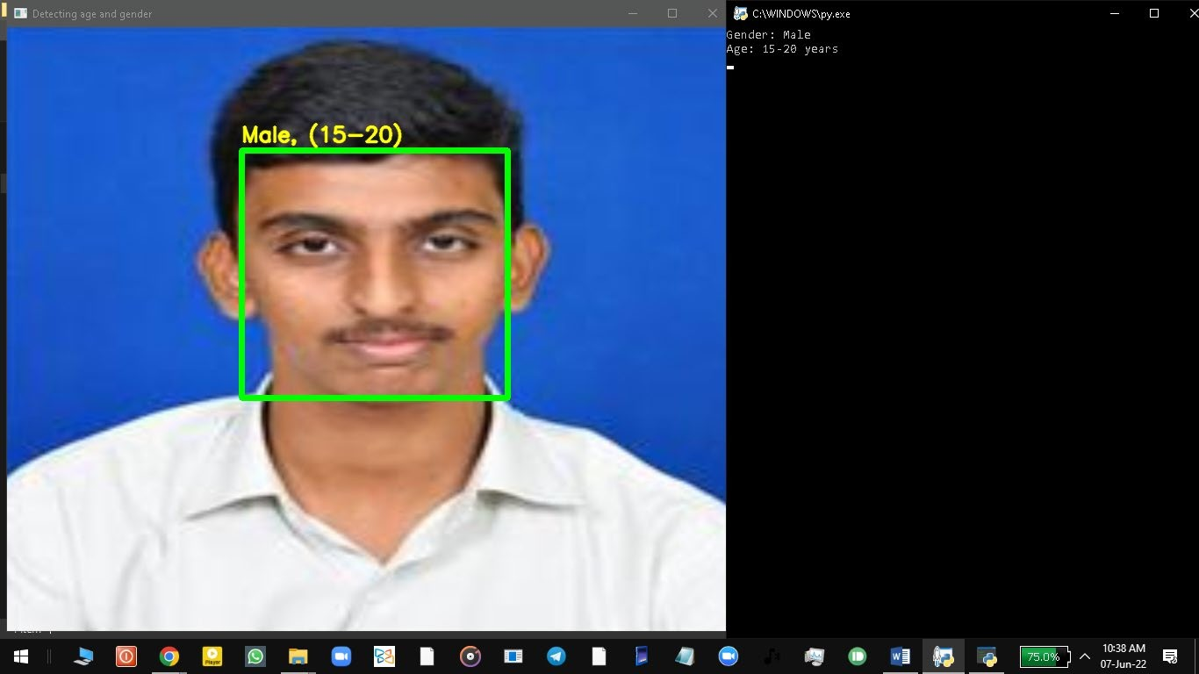
2.INPUT FROM IMAGE

Slide 7
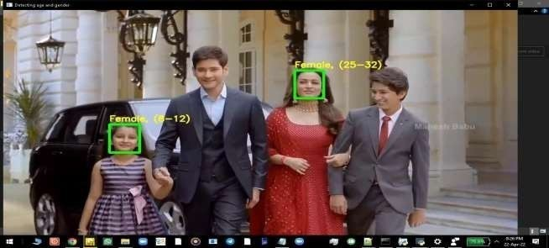
3.INPUT FROM VIDEO

Slide 8
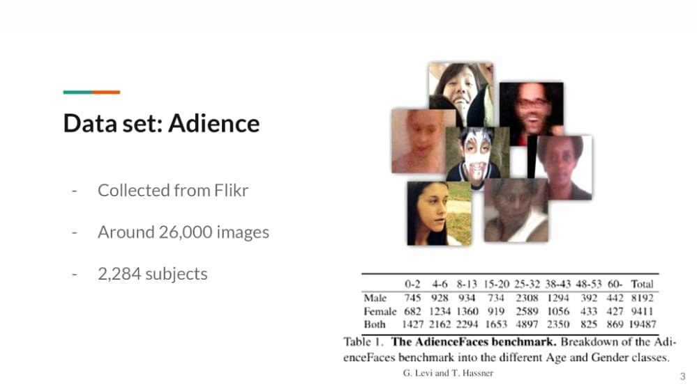
BENCHMARK ADIENCE DATA SET

Slide 9
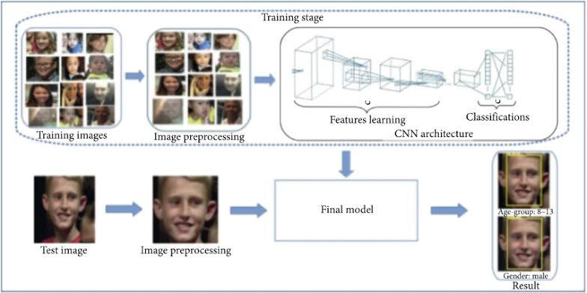
WORKING OF THE PROJECT

Slide 10
NEED FOR THE PROJECT
Automatic age and gender classification has become relevant to an increasing amount of applications, particularly since the rise of social platforms and social media.
Performance of existing methods on real-world images is still significantly lacking.
By learning representations through the use of deep-convolutional neural networks (CNN), a significant increase in performance can be obtained on these tasks. we used a simple convolutional net architecture that can be used even when the amount of learning data is limited.

Slide 11
INTRODUCTION
Age and gender play fundamental roles in social interactions. Languages reserve different salutations and grammar rules for men or women, and very often different vocabularies are used when addressing elders compared to young people.
Therefore automated translation services and other forms of speech generation can factor in gender and age classification of subjects to improve their performance. Having an idea about the age and gender of a person makes the task of interaction with them easier.

Slide 12
LITERATURE SURVEY
We developed our project by taking the reference of PhD publication paper of Tal Hassner and Gil Levi .Our main intention is to find the criminals by filtering them by using particular age group and gender. For us to be able to build a system and choose which models/techniques to use, we need to know what is being used by other approaches with results that could satisfy our goals. First, we need to identify which approach is being used the most with satisfactory results: this is the case of Deep Learning, which is used across all recent papers we investigated, where all of them use, more specifically, Convolutional Neural Networks. Deep learning has shown considerable improvements when compared to older algorithms, especially when processing images and videos, which covers problems like object detection, object recognition and speech recognition, which are areas where our theme falls into. This explains why latest approaches are currently all adopting Deep Learning to solve these issues.

Slide 13
EXISTING SYSTEM
The existing projects till date are less accurate and they can’t predict accurately in noise conditions and less lighting conditions developed using UTK face. Over the past several years, the studies are undergoing on the areas of facial feature extraction and predicting age and gender based on that. To address this concern scientists had come up with various approaches, and each of these approaches solved some critical problems that were raised in this field. For predicting age and gender accurately, even some of the minor differences in the images should be extracted carefully. Extracting facial features to that extent is challenging and only a few approaches focused on solving this problem. Those minor differences include size of the eyes, ears, mouth and the distances between them. most of early methods have focused on images which were maintained in lab conditions (like maintaining ideal lighting, angle of the image, etc.). very few methods have addressed the difficulties that arise when applying these methods to real world images.

Slide 14
PROPOSED SYSTEM
Here we developed this project using adience data set which is a benchmark data set which gives better detection and prediction than existing projects.In this proposed system, we will develop a deep learning model using Convolutional Neural Networks and Caffe framework. The model receives the image, passes it through different layers by reducing the size in each layer. We then train our model using the Adience Benchmark Dataset from Kaggle which contains over 26,000 images of human beings which include different ethnicity, color, and many more factors. The dataset also provides a label for each image. Once the model is trained, we can use the model for testing. We first detect the presence of a human in each image. Then, we process the image using the OpenCV framework to obtain all the human faces present in the image. Each face is then processed by a developed deep learning model to get the output label which essentially gives us the age and gender of each person in the image.

Slide 15
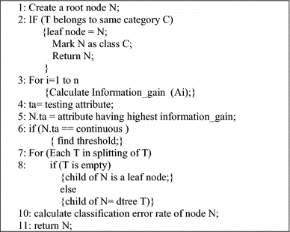
J48 ALGORITHM

Slide 16
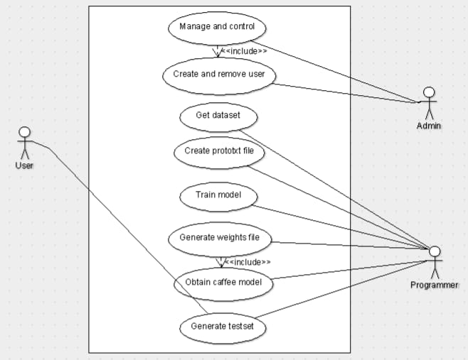
UML DIAGRAMS USE CASE DIAGRAM:

Slide 17
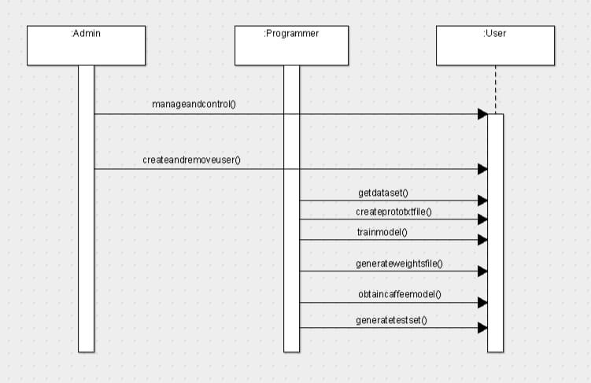
SEQUENCE DIAGRAM:

Slide 18
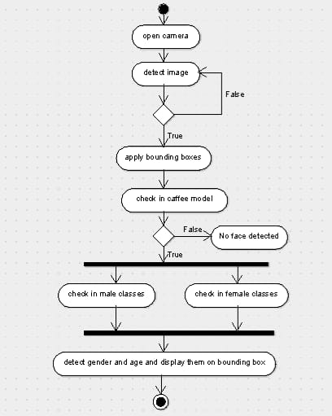
ACTIVITY DIAGRAM:

Slide 19
REQUIREMENTS
Software Requirements:
Operating System : Windows
IDE : Microsoft Visual Studio Code
Programming language : Python
Packages : Open CV
Framework : Caffe
Minimum Hardware Requirements:
Processor : Intel i3 or greater
RAM : 4GB
Hard disk : 30GB

Slide 20
PROJECT OVERVIEW
We used Adience dataset for age and gender classification.
Trained CNN (Convolutional Neural Networks) using Adience dataset for age and gender prediction.
Created a python application using OpenCV deep learning module to perform real time age and gender detection.

Slide 21
CONVOLUTIONAL NEURAL NETWORKS
Convolutional neural networks are a special type of feed-forward networks. These models are designed to emulate the behavior of a visual cortex. CNNs perform very well on visual recognition tasks.
These networks have 3 types of layers: Input layer, hidden layer and output layer. In these networks, data moves from the input layer through the hidden nodes and to the output nodes.
The convolutional, pooling and ReLU layers act as learnable features extractors, while the fully connected layers acts as a machine learning classifier.

Slide 22
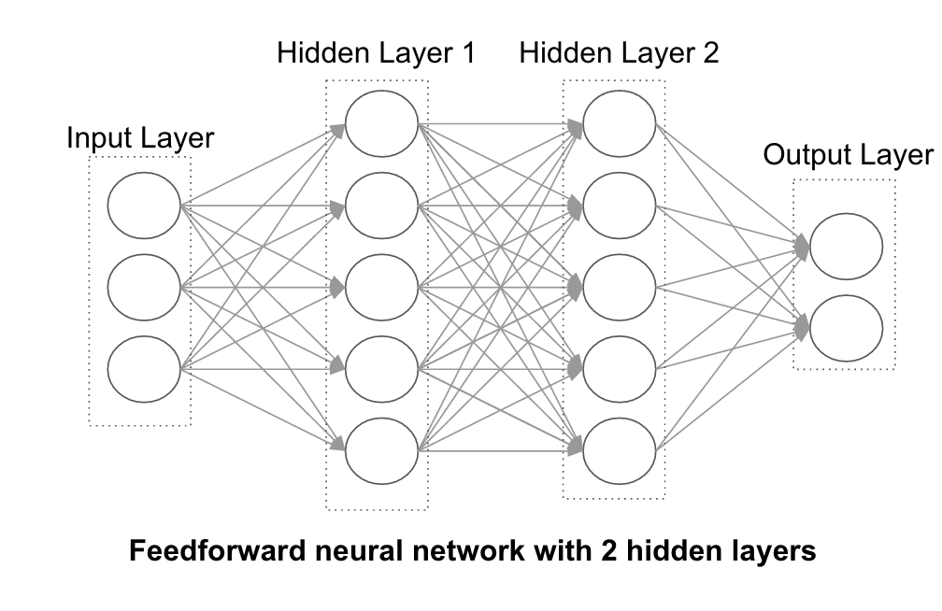
SYSTEM DESIGN

Slide 23
CNN FOR GENDER AND AGE ESTIMATION
Data-sets for age and gender estimation from real-world social images are therefore relatively limited in size and presently no match in size with the much larger image classification data-sets.
Over fitting is common problem when machine learning based methods are used on such small image collections. This problem is exacerbated when considering deep convolutional neural networks due to their huge numbers of model parameters. Care must therefore be taken in order to avoid over fitting under such circumstances.

Slide 24
NETWORK ARCHITECTURE
The network comprises of only three convolutional layers and two fully-connected layers with a small number of neurons.
Images are first rescaled to 256 X 256 and a crop of 227 X 227 is fed to the network.
Each convolutional layer, followed by a rectified linear operator (ReLU), a max pooling layer taking the maximal value of 3 X 3 regions with two-pixel strides and a local response normalization layer.
Last fully connected layer maps to the final classes for age or gender.

Slide 25
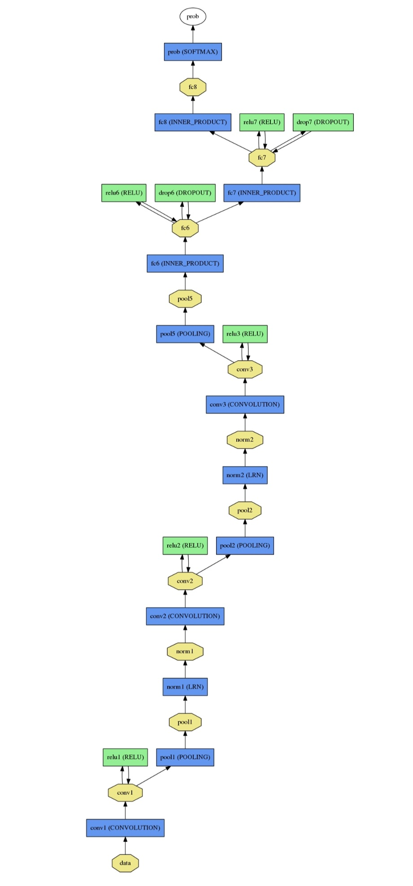
NETWORK ARCHITECTURE DIAGRAMS:

Slide 26
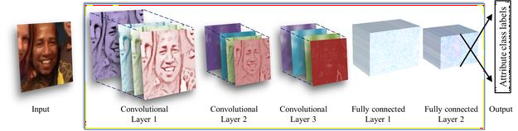
LAYERS

Slide 27
TRAINING AND TESTING
Training a CNN using Caffe framework
Step 1 - Data preparation: store images in a format that can be used by Caffe. We will write a Python script that will handle both image pre-processing and storage.
Step 2 - Model definition: In this step, we choose a CNN architecture and we define its parameters in a configuration file with extension .prototxt.
Step 3 - Solver definition: The solver is responsible for model optimization. We define the solver parameters in a configuration file with extension .prototxt.
Step 4 - Model training: We train the model by executing one Caffe command from the terminal. After training the model, we will get the trained model in a file with extension .caffemodel.
Testing for both age or gender classification is performed using a standard five-fold cross-validation protocol.
Split the images into 5 folds and then perform a subject-exclusive cross-validation protocol. The reason this type of protocol is necessary is because of the nature of the dataset being used, which contains multiple pictures of the same subjects. Therefore if the images were simply randomly shuffled and divided into fifths, the same subjects could potentially appear in both the training and test folds. This protocol therefore ensures that all the images of a given subject appear in a single fold to avoid this issue.

Slide 28
ADVANTAGES
If we know the gender and age of the person we can use specific vocabulary to make them understand (for example if we know the particular age group of children then we can act accordingly)
It even helps in identifying criminals when we have the picture of the criminal and we then classify the age of the person so it will be helpful to search for the person only in that particular age group

Slide 29
APPLICATIONS
Applications for this technology have a broad scope and the potential to make a large impact. This could be used to aid assisted vision devices for those with deteriorating, or lost, eyesight.
Social media websites like Facebook could use the information about the age and gender of the people to better infer the context of the image.
In human machine interaction.

Slide 30
CONCLUSION
CNN can be used to provide improved age and gender classification results, even considering the much smaller size of contemporary unconstrained image sets labeled for age and gender.
The simplicity of the model implies that more elaborate systems using more training data may well be capable of substantially improving results beyond these results.
One can also try to use a regression model instead of classification for Age Prediction if enough data is available.

Slide 31
REFERENCES
Jo Chang-yeon, “Face Detection using LBP features”, 2022, Retrieved February 19, 2022 from: http://citeseerx.ist.psu.edu/viewdoc/summary?doi=10.1.1.217.6206. doi: 10.1.1.217.6206
Nagesh Singh Chauhan (2021), Predict Age and Gender using Convolutional Neural Network and openCV. Retrieved from https://towardsdatascience.com/predict-age-and-gender-usingconvolutional-neural-network-and-opencv-fd90390e3ce6
Gil Levi and Tal Hassner Age and Gender Classification Using Convolutional Neural Networks. IEEE Workshop on Analysis and Modeling of Faces and Gestures (AMFG), at the IEEE Conf. on Computer Vision and Pattern Recognition (CVPR), Boston, 2015.

Slide 32
THANK YOU
Any Queries???
Please Feel Free To Ask.

